Slide 2
I am originally from Greensboro, NC. I am married with two children, Brayden (12) and Camryn (6). I am a two-time graduate of North Carolina A&T State University, receiving both my undergraduate and Master’s Degrees. I am currently a student in the Doctoral Program at Gardner Webb University.
I am happy to have your child in my class! This year will be packed full of learning and surprises. I plan to work closely with you to ensure your child’s success. I am eager to get to know you and your family!
I can be reached at
School: 336-316-5888
Email: jeffrib2@gcsnc.com
Class Tag

Slide 3
This year we will use American Reading Company (ARC) Curriculum for 4th Grade English/Language Arts. This will enhance your child’s reading abilities and encourage better reading behaviors. Science and Social Studies will be integrated within this program.
We will also require they read at home for at least 30 minutes nightly and complete their Reading Logs.

Slide 4
We will be encouraging your child to write in order to express their feelings and relay information based on what they have learned in the classroom and through reading.

Slide 5
Eureka Math is the Math Curriculum we will use this year. This program is designed to engage your child and encourage a LOVE for math. We will learn new and exciting ways to solve problems.

Slide 6
Your child WILL receive Eureka homework nightly. It is important that the homework is completed nightly and submitted daily. Your child will receive points for homework as a grade and as an incentive.

Slide 7
Music – Anthony
Physical Education – Glynn
Art – Holt
Media – Carrington
Computer - Williams

Slide 8
Listen when someone is talking.
Follow directions the first time they are given.
Treat everyone with kindness and respect.
Take care of our school and classroom.
Work and play safely and quietly.
It’s ok to make mistakes.

Slide 9
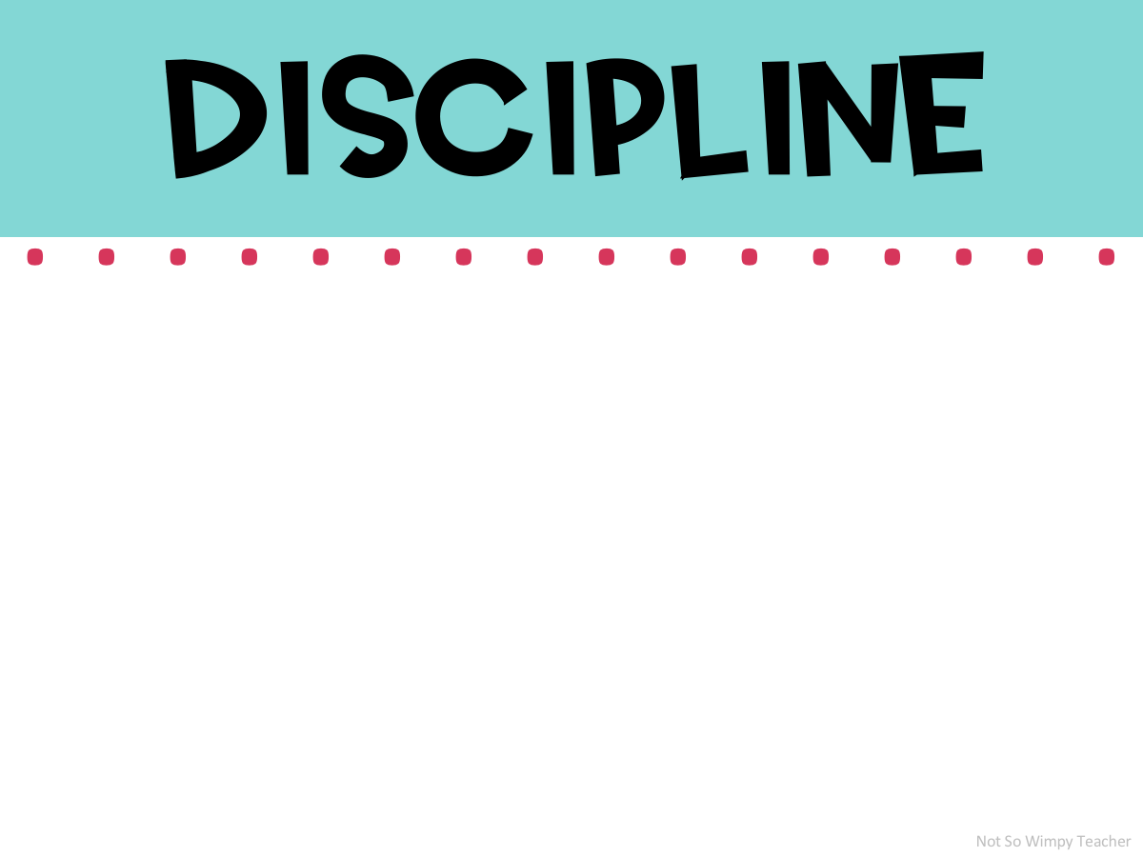
We are hopeful all of the children will be on their best behavior. However, we know sometimes they have an “off day.” We promise not to call you for every negative behavior. If we do need to call you, please note we have done all we could in the classroom and given at least 3 chances for him/her to correct their behaviors.

Slide 10
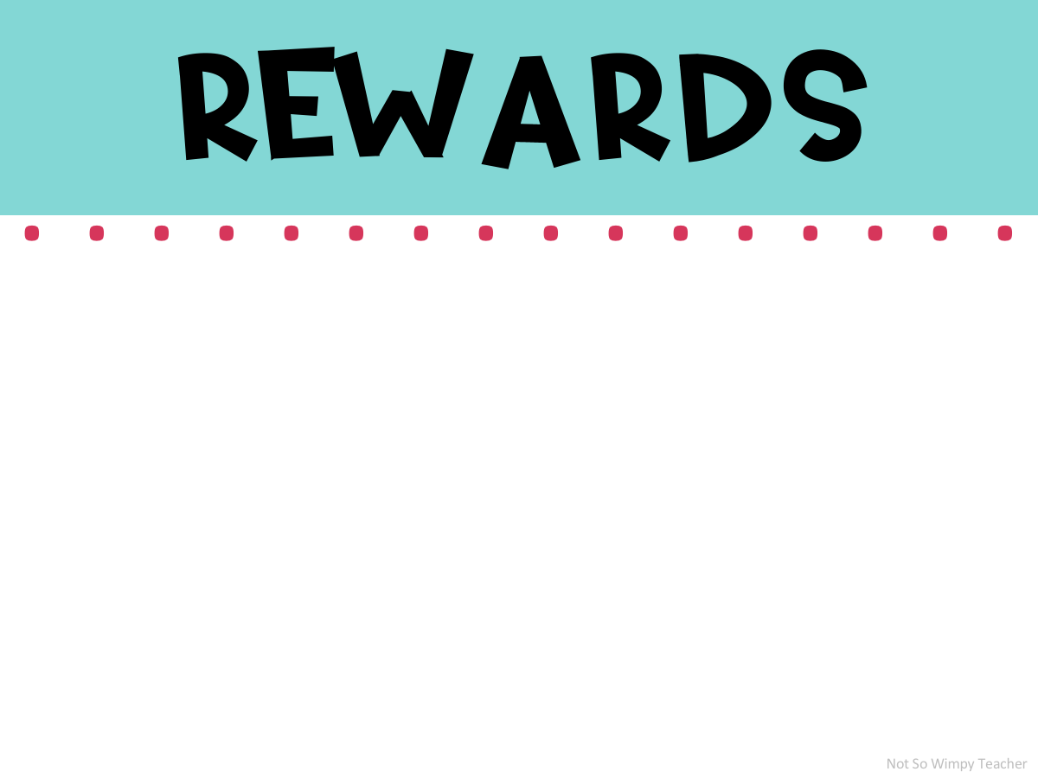
We have a ticket system through PBIS for our school. The children will receive tickets from all of their teachers and anyone in the building who catches them doing something great!
There will also be other classroom incentives offered throughout the year!

Slide 11
Grades will be given based on participation or classwork, completed homework, completion of weekly reading logs, Math and English/Language Arts Requirements.
The children may sometimes receive points for assignments. In other cases, such as assessments and projects, they will receive a grade.

Slide 12
Parents are always welcome in our classroom. We appreciate any time that you give to volunteer in our classroom. Please feel free to come in at any time. You must go online and register as a volunteer on the Guilford County Schools Website.
On many occasions we will ask for volunteers to assist with different activities in the classroom. We hope that you will consider being an active part of your child’s Fourth Grade year!

